Slide 1
Health News for Coming to the Yukon
Introduction to the Canadian Health System
Sexual and General Health for
Yukon College International Students

Slide 2
BEING HEALTHY
Health is about your body, mind and emotions, not just not being sick
Good rest, nutrition, hygiene, exercise and feeling like we are doing a good job help us feel healthy
Heathy relationships are important to health and wellbeing

Slide 3
SEXUAL HEALTH
If you’re not used to talking about sexual health, it can be hard to hear about it or talk about it
It can be hard to ask for information or help
You might find Canadians more open in talking about sexual things than you are used to

Slide 4
You might see surprising things around town and the campus… This is to help women planning to drink alcohol to think first about whether they might be pregnant, as alcohol permanently harms a fetus. Women can quickly check.
North American Culture

Slide 5
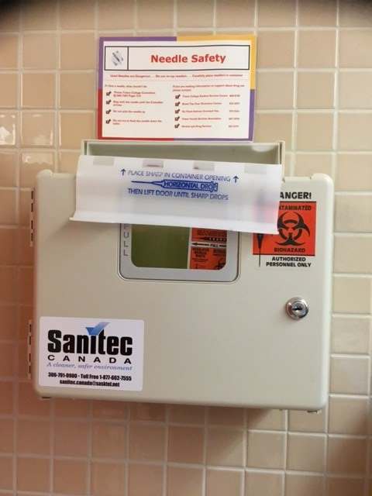
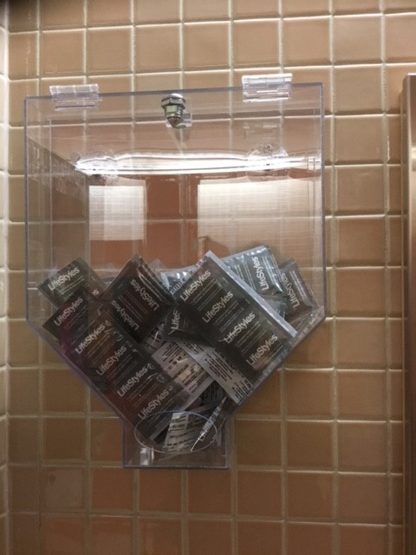
North American Culture
To prevent disease transmission, condoms and needle disposals are readily available.

Slide 6
North American Culture
There is a value of acceptance of people of different gender identities
LGBT (lesbian, gay, bisexual, transgender) rights are protected in laws and polices
At Yukon College, gender discrimination is treated the same as racial, ethnic, or faith based discrimination
We want all people to feel safe

Slide 7
To help people of all genders and identities feel safe in our bathrooms, many are all gender: for everyone

Slide 8
MAKE HEALTHY CHOICES ABOUT SEX
Think before you choose: do you feel safe? pressured?
how well do you know the person? Have you talked
about it with each other?
Alcohol and drugs lead to poor choices
Loneliness can lead to poor choices, too
Consent: only you can decide what happens to you
It is OK to say no

Slide 9
You can’t give or accept consent if you are under the influence of alcohol or drugs.
Forcing “consent” is not OK.
NO means NO

Slide 10
WHAT IS CONSENT?
Consent means that both people in a sexual encounter must agree to it, and either person may decide at any time that they no longer consent and want to stop the activity. Consenting to one behaviour does not obligate you to consent to any other behaviours. Consenting on one occasion also does not obligate you to consent on any other occasion. Consenting means only that at this particular time, you would like to engage in this particular sexual behaviour.
http://www.pamf.org/teen/abc/sex/consent.html#What%20is%20consent?

Slide 11
Why do we want you to understand consent
Any kind for forcing or coercion in intimate relationships is not tolerated in Canadian society
Violence - physical or sexual - in intimate relationships can have serious consequences, including legal charges
The implications of charges?
If you feel you are being coerced or abused, what can you do?
https://www.yukoncollege.yk.ca/about-us/governance/policies College policy on sexualized violence and response

Slide 12
HELP FOR HEALTHY CHOICES
Protect yourself and your partner
Condoms are available on campus and lots of places in town, to prevent pregnancy or disease transmission
Not sure how you feel? Talk to a counselor, health professional, a trusted friend
Know where to go for information

Slide 13
Medical Clinic
406 Lambert St, Whitehorse
(867) 393-6635
 | Tuesday 12:30 pm - 4:00 pm 5:00 pm - 7:00 pm
 | Wednesday 9:00 am - 12:00 pm 1:00 pm - 4:00 pm
The clinic is led by Nurse Practitioners, who can diagnose and treat many illnesses

Slide 14
WHAT KIND OF THINGS CAN I GO THERE FOR?
Sexual health check-up (breast health, testicular health…)
Getting tested for STIs (sexually transmitted diseases)
Making decisions around sexual activity
Birth control, pregnancy
Counseling and education
Sexual identity questions

Slide 15
A few other resources
http://www.bettertoknow.yk.ca/
Options for Sexual Health: optionsforsexualhealth.org

Slide 16
1-800-SEX-SENSE (1-800-739-7367) someone to talk to about anything to do with sexual health, completely anonymous

Slide 17
Yukon Communicable Disease Control
Monitors and manages all infectious diseases
Screening and testing for all infections diseases
Client confidentiality is always protected
Hours of Operation: Monday to Friday Appointments – 8:30am to noon Drop-in – 12:30pm to 4:00pm
Phone: 867-667-8323

Slide 18
Canadian Health Care
Health care in Canada is delivered by many different health practitioners
Doctors work in teams in clinics with support staff, who are often not health professionals (so might not be the people to ask health questions)
Family doctors also look after their patients in hospital, along with the hospital care team

Slide 19
How do you find a doctor?
Looking for a doctor?
You can call 393-6988 for a list of doctors who are accepting patients
Talk with Yoshie or Jonathon for guidance, and remember the clinics that are for everyone

Slide 20
Health Care Team
Registered nurses work in many areas, and provide most of the care in smaller communities outside of Whitehorse
Questions about medications? Pharmacists are the best resource
There are many other professionals to meet patients’ needs:
physiotherapists, dieticians, social workers etc.

Slide 21
Mental Health
You are meeting Yukon College’s counselor this week; free counseling through the college is your first and best contact for many things that can cause mental health challenges for students
There are community mental heath and hospital based teams for care when needed.

Slide 22
Whitehorse General Hospital
If you need to go to the hospital, you will first talk to admissions staff, then be sent to the Emergency Department for “triage” by a registered nurse
Triage is the process of assigning urgency to each patient who comes to emergency
The most urgent, or acutely ill, patients receive care first
Less urgent needs can take longer, and patients can wait some time in busy periods

Slide 23
Whitehorse General Hospital
Your insurance will be checked to arrange payment for hospital car
Ambulance costs are also covered by the patient/insurance for anyone not a Yukon resident
How much do you think a day in intensive care would cost?
$5894/day!!
So... it's really important to work with Yoshie for your insurance coverage
If you need to go to the hospital by ambulance, you will go straight to the emergency department, payment will be sorted out later

Slide 24
Questions?
What else can I tell you about to set you up for the best of health during your time at Yukon College?

