Slide 1
Open Educational Resources Workshop
Aline Goncalves
Martha Burkle
IT & Learning Commons
Feb 10, 2016

Slide 2
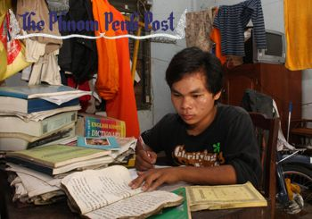
OER DEFINITION
Introduced by UNESCO in 2002:
“Teaching, learning, and research materials in any medium, digital or otherwise, that reside in the public domain that permits no-cost access use”

Slide 3
Importance of using OERs
Leading trend in education
Education for all principle
Technology engaged students
Familiarity with online resources
Instant update
Rights and responsibility of contribution to Knowledge

Slide 4
What are Open Educational Resources (OER)?

Slide 5
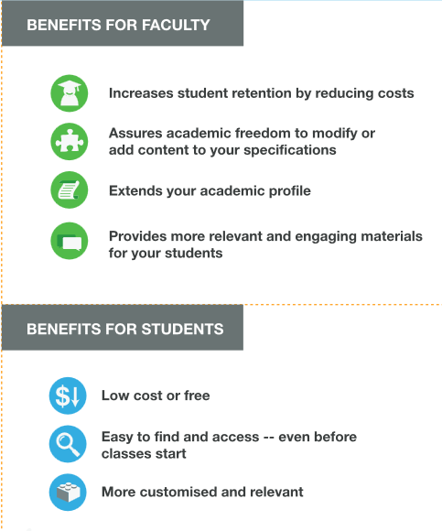

Slide 6
Open Textbooks
Open Journals

Slide 7
http://open.bccampus.ca/
Quick facts
Announced October 2012
Canada's first official open textbook project
Openly licensed using Creative Commons license
40 top subjects
Collection contains over 70 openly licensed textbooks

Slide 8
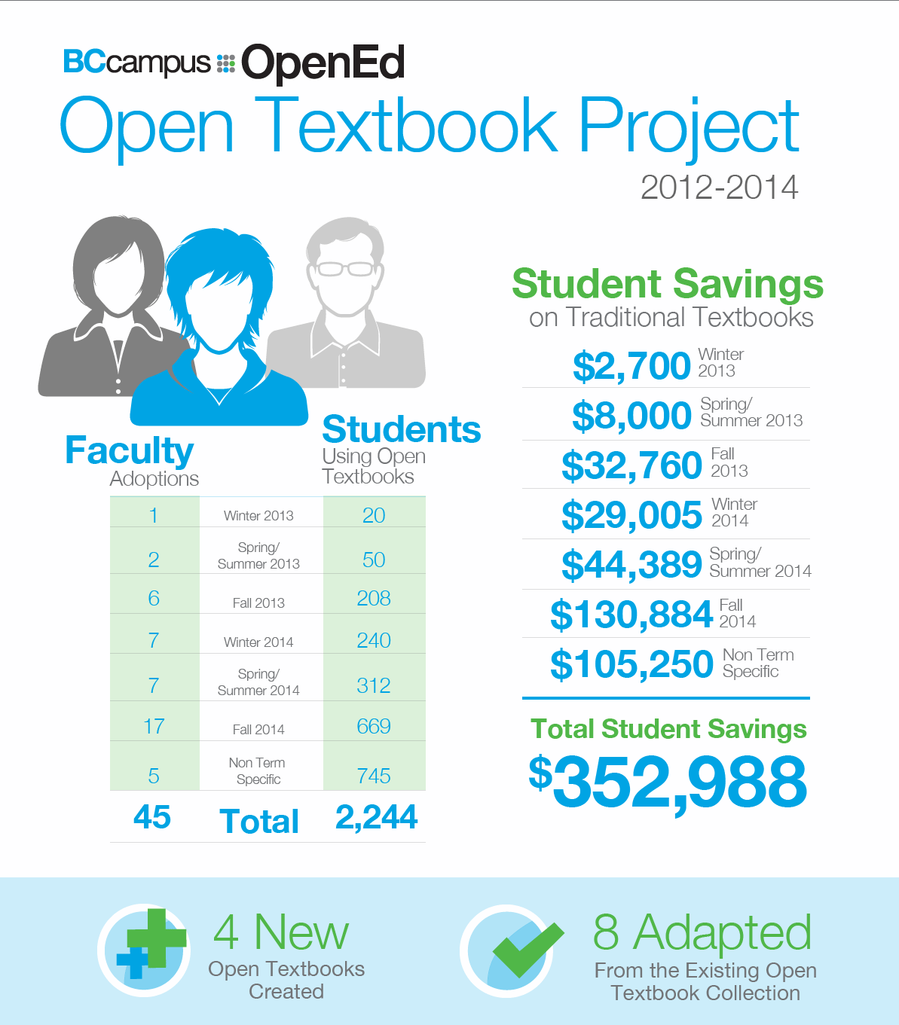
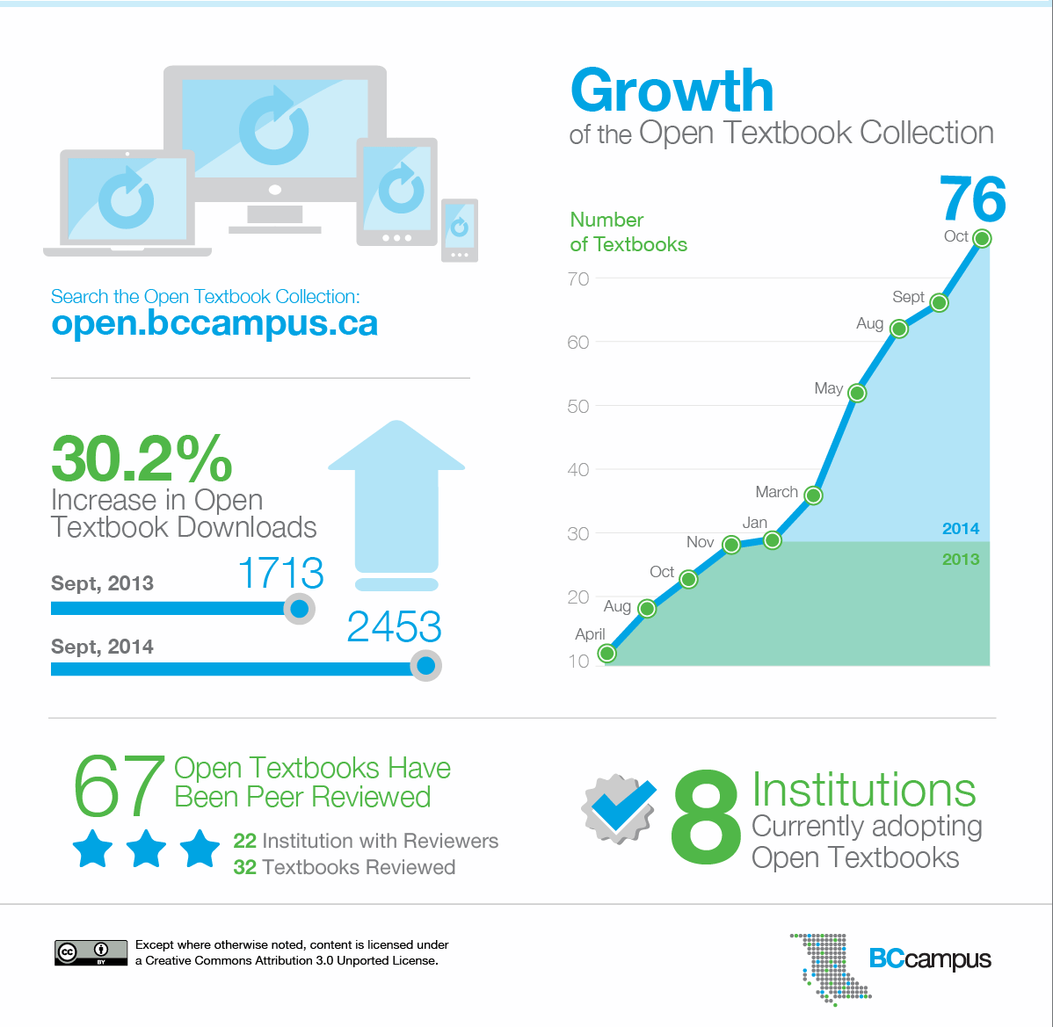

Slide 9
More BC Open Textbook Stats
As of January 18, 2016
Open Textbook Adoptions
Student savings | $1,154,100- 1,437,240
Number of students using open textbooks | 11,541
Number of institutions currently adopting | 25 (20 Public, 5 Private)
Top 4 adopting institutions (in order) | KPU, Camosun, Langara, JIBC
Number of faculty adopting | 109
Number of known adoptions | 372
BC Open Textbook Collection
Number of textbooks | 138
Number of trades textbooks | 55
Number of Top 40 textbooks | 83
Top 3 most adopted textbooks | College Physics, Database Design, Writing for Success
Number of print-on-demand textbooks purchased since 2012 | 219

Slide 10
OER ACADEMIC JOURNALS
Open Access Journals Directory:
https://doaj.org/
Open Journals by institution
Athabasca University: http://www.aupress.ca/index.php/journals/
Oxford University Press:
http://www.oxfordjournals.org/en/oxford-open/index.html

Slide 11
BEYOND OER PRINTED MATERIALS
Open Access Video resources
https://www.ted.com/talks
Open online resources
http://crln.acrl.org/content/73/6/334
Telerik educational videos:
http://www.telerik.com/videos

Slide 12
Thanks and Q&A
To continue the conversation, please contact us:
Aline Goncalves: agoncalves@yukoncollege.yk.ca
Martha Burkle: mburkle@yukoncollege.yk.ca

